Slide 1
http://www.vidyanidhi.com/
ketkiacharya.net@gmail.com
Ketki Acharya
From: SM VITA ATC of CDAC
9769201036
ketkiacharya.net@gmail.com

Slide 2
Name space
In all code of console application we see 1st line
using System
This is name space having all classes related to input out put.
In Visual studio open Object explorer, under mscorlib node you have {}System. within this look for Console class.
See diagram in next slide

Slide 3
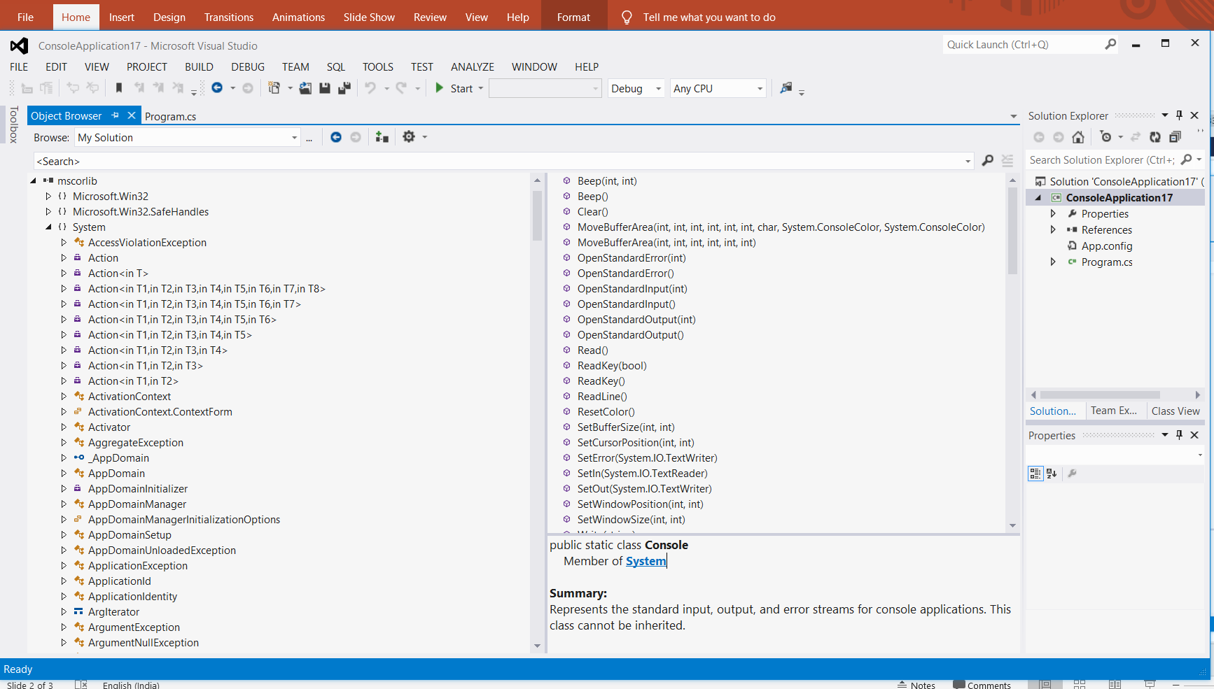

Slide 4
Name space to avoid name collision
namespace CADac
{
class students
{
public void dacresult()
{
Console.WriteLine("Result of DAC students");
}
}
namespace CADbda
{
class students
{
public void dbdaresult()
{
Console.WriteLine("Result of dbda students");
}
}
In this example I have 2 name space CADac andCADbda both has classs students.
Due to namespace there is no name collision
We can easily use both class because they both are in different name space
using System;
namespace ConsoleApplicationdemo
{
class Program
{
static void Main(string[] args)
{
CADac.students s1 = new CADac.students();
CADbda.students s2 = new CADbda.students();
s1dacresult();
s2.dbdaresult();
}
}
}

Slide 5
Namespace to logically grouping of data
namespace CADac
{
class Students
{
public void dacresult()
{ Console.WriteLine("Result of DAC students");
}
}
class Reportcard
{ //some code
}
}
namespace CAStaff
{
class Employee
{
public void paysal()
{ Console.WriteLine("salary given to stadd");
}
}
class Address
{ //some code
}
class visitingfaculty
{ //some code
}
}
using System;
using CADac;
using CAStaff;
namespace ConsoleApplicationdemo
{
class Program
{
static void Main(string[] args)
{ Students s1 = new Students();
s1.dacresult();
Reportcard r1 = new Reportcard();
Employee e1 = new Employee();
e1.paysal();
Address a1 = new Address();
}
}
}
You can see in this example all Dac related class are in namespace CADac name space
And all staff related class are in CAStaff name space. So name space help us to logically grouping of related classes. In entry point class we have added namespace CADac, , CAStaff
In Dot Net frame work all class realtered to file handling is in namespace System.io;

Slide 6
using static System.Console;
class Program {
static void Main()
{ WriteLine(“hello”);
}
}
the scope of a using directive is limited to the file in which it appears.
The using directive can appear:
At the beginning of a source code file, before any namespace or type definitions.
In any namespace, but before any namespace or types declared in this namespace.
Otherwise, compiler error CS1529 is generated.

